Slide 1
Office 365 development
Speaker name

Slide 2
Deep dive into SharePoint Lists with CSOM APIs

Slide 3
Agenda
Motivation
CSOM Overview
Optimizing the Execution of CSOM Queries
Creating Lists and Document Libraries
Registering Remote Event Receivers

Slide 5
1
Motivation

Slide 6
SharePoint add-in building blocks
SharePoint add-ins
aspx
js
C#
Databases
png
CSS
master
Web Services
REST
SharePoint
CSOM
SharePoint API
Service Applications
List and libraries
Managed metadata
Search service
Workflow Service
BCS

Slide 7
Why Client Object Model (CSOM)?
Advantages of CSOM over the REST API
Strongly-typed programming
Higher productivity when writing C# or VB.NET
Provides ability to batch requests to web server
Some areas are covered by CSOM but not REST
Notes:
x

Slide 8
2
CSOM Overview

Slide 9
Supported Areas
What can you do with CSOM?
Work within a specific site collection
Read and modify site properties
Create site columns and content types
Create lists, items, views and list types
Register remote event handlers
Create folder and upload and download files
Add web part and web part pages
Notes:
The Client Object Model contains a lot of overlap coverage with the full SharePoint API. A lot activities that are possible through the SharePoint API, are also possible through the different client object models.

Slide 10
CSOM Expansion in SharePoint 2013?
New APIs with SharePoint Server functionality
User Profiles
Search
Taxonomy
Feeds
Publishing
Sharing
Workflow
E-Discovery
IRM
Analytics
Business Data
Further changes in SharePoint 2016
Notes:
This slide above lists new areas in the SharePoint 2013 remote API that are accessible through both CSOM and REST. This is a welcome change because most of this functionality is only available through server-side APIs in a SharePoint 2010 farm. You can also see adding this remote access is very important to the new app model where developers can no longer run code in a SharePoint environment not can they access the server-side APIs.

Slide 11
SharePoint Remote API Architecture
_api is new alias for _vti_bin/client.svc
Server
Client
OData
Execute Query
C#
js
.NET CLR Library
JavaScript Library
Custom Client Code

Slide 12
Programming using CSOM
Browser
js
SharePoint
Your JS Code
JS OM
Proxy
XML Request
JSON Response
client.svc
Server OM
Managed Client
Content database
Your .NET Code
Managed OM
Proxy
XML Request
JSON Response
C#

Slide 13
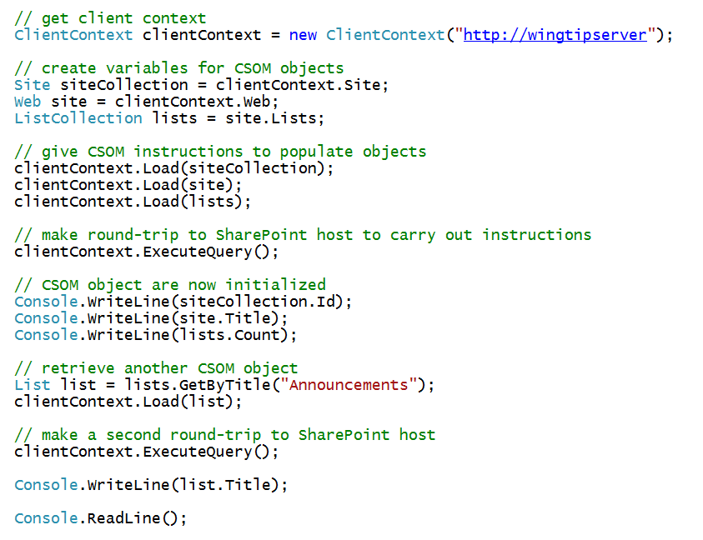
CSOM using Managed Code
Notes:
The slide shows an example of CSOM code which accomplishes the following:
Establishes a connection to the SharePoint farm using default credentials
Retrieves information about the current site
Creates a new Contacts list
Retrieves and display information about the lists in the current site

Slide 14
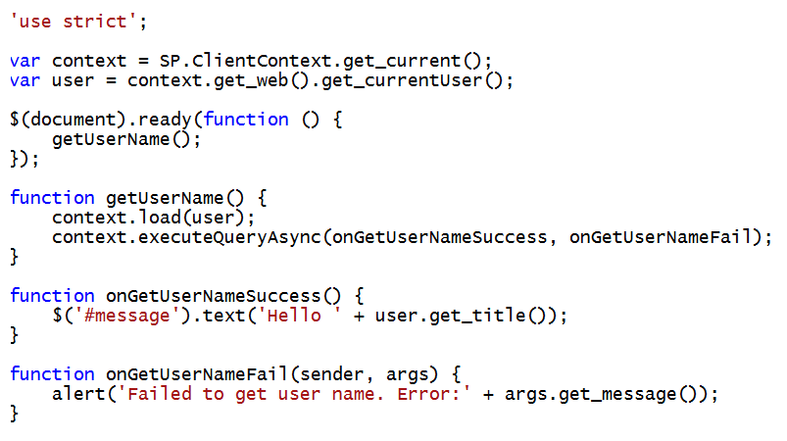
CSOM using JavaScript
Notes:
This slides shows a typical example using the CSOM from JavaScript behind a page in a SharePoint 2013 site. This code also leverages jQuery and in particular the document ready function to execute the onPageLoad function when the DOM is ready to access. Note how this code calls ExecuteOrDelayUntilScriptLoaded to force the download of sp.js before executing the initializeCSOM function. This is a common practice to ensure that that CSOM is available for use before you begin to program against it.

Slide 15
Authentication using CSOM
CSOM support user auth and app auth
User auth can use Windows of Forms Authentication
External auth used for apps with server-side code
Set authentication mode:
clientCtx.AuthenticationMode =
ClientAuthenticationMode.FormsAuthentication;
Specify user authentication details:
FormAuthenticationLoginInfo loginInfo = new FormAuthenticationLoginInfo(“User”,”password”);
clientCtx.FormsAuthenticationLoginInfo = loginInfo;
Notes:
By default, the managed client object models authenticate users by using their Windows credentials (DefaultCredentials). Optionally, you can change the authentication mode on the ClientContext object and specify using Forms authentication instead. A user must then supply a user name and password through properties on ClientContext. Behind the scenes, SharePoint Foundation calls the Authentication Web service, obtains the correct cookie, and then makes the necessary object model calls. To run managed client code against a Forms authentication server, you must change to Forms authentication. This requirement does not apply to the JavaScript object model.
The managed client object models provide a ClientAuthenticationMode enumeration whose values are Anonymous, Default, and FormsAuthentication. To specify Forms authentication, use code similar to the following:
clientContext.AuthenticationMode = ClientAuthenticationMode.FormsAuthentication;
In addition to setting the authentication mode, you must specify the user name and password information, such as follows:
FormsAuthenticationLoginInfoformsAuthInfo = new FormsAuthenticationLoginInfo("MyUser", "MyPassword");
clientContext.FormsAuthenticationLoginInfo = formsAuthInfo;
Note: The account name and password in formsAuthInfo are sent in clear text, so you must use HTTPS protocol instead of HTTP.

Slide 16
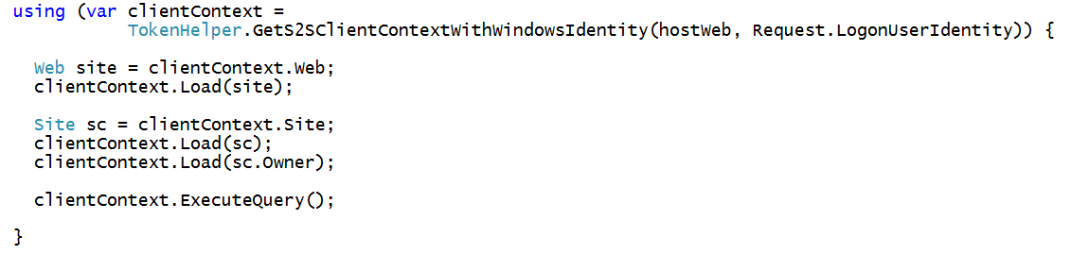
Authenticating from the Remote Web
Create client context with access token
Call GetS2SClientContextwithWindowsIdentity
Commonly done inside using statement
Pass null value for user name for App-only identity

Slide 17
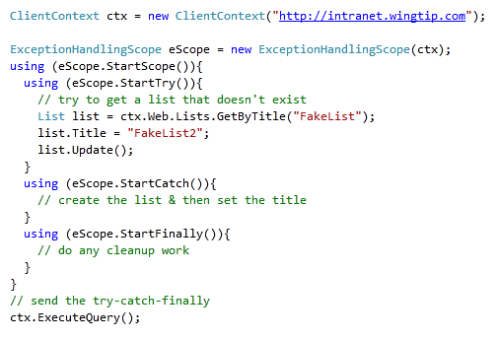
Remote Error Handling
CSOM supports structured exception handling
However, it’s an API not a language feature
Reduces chatty & time consuming round-trips to server
Notes:
After creating the ClientContext, you can create a ExceptionHandlingScope. You can wrap up all your code that communicates with the client object model within a using(eScope.StartScope()){...} to avoid that exceptions go back and forth over the wire. All exceptions are queued and can be checked in the using (StartCatch()){...} part of your code.

Slide 18
3
Optimizing the Execution of CSOM Queries

Slide 19
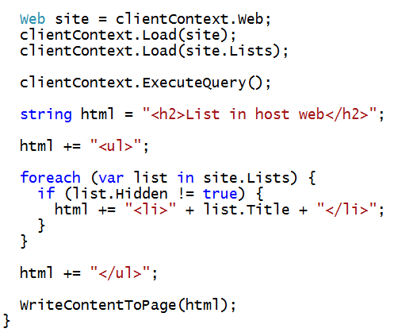
What’s Wrong with This Code?

Slide 20
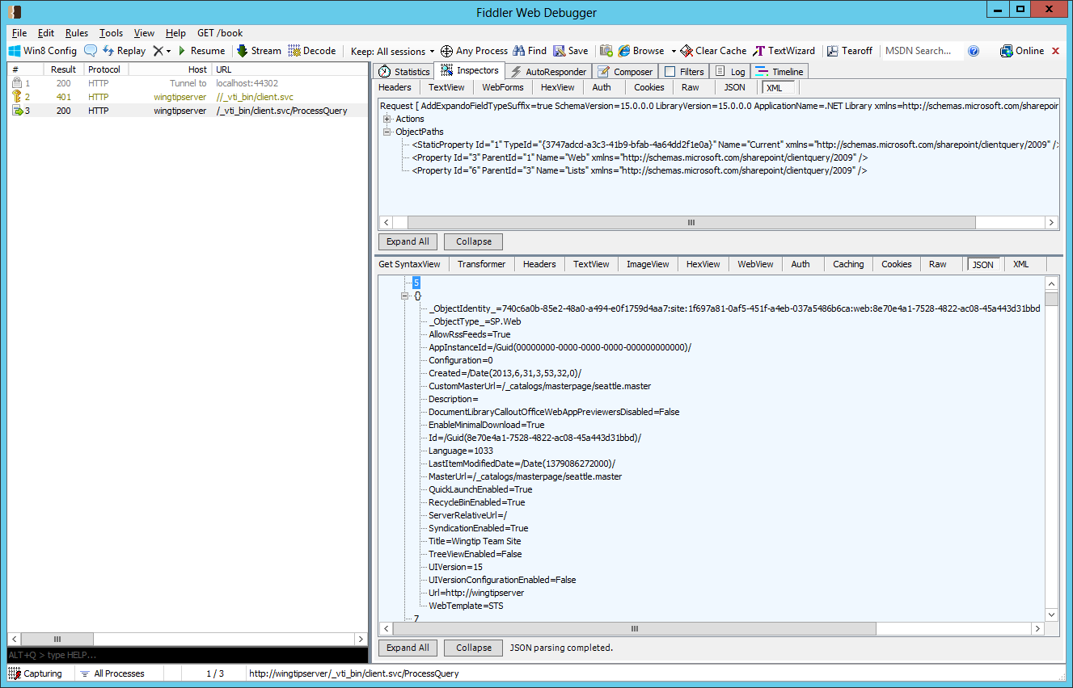

Inspecting CSOM Calls using Fiddler

Slide 21
Lambda Expressions
C# supports the use of lambda expressions
Syntax Introduced as part of LINQ with .NET 3.5
Can (and should) be used with CSOM programming
Lambda expression is an anonymous function
It defines a parameter list and a function body
[Parameter_list] => [Function_Body]
Input Parameter(s)
Lambda Operator
Statement Block
read as "value goes into value starts with B"

Slide 22
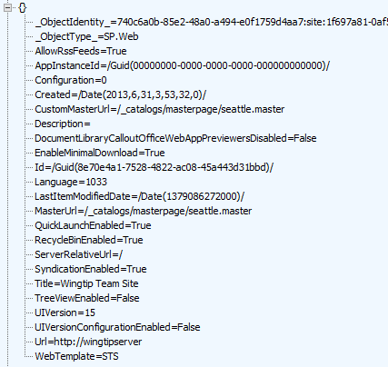


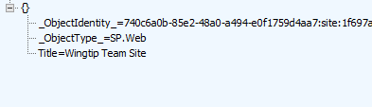
Using Lambda Expressions
Loading an object populates all scalar property values
Can result in inefficient use of network bandwidth
Lambda expressions can be used to optimize
You can indicate which properties you want populated

Slide 23
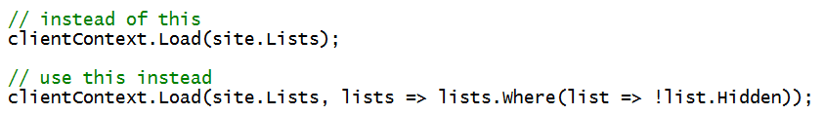
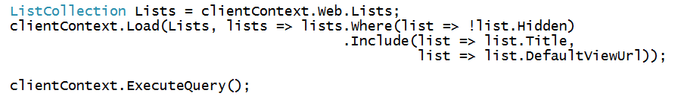
Using Where() and Include()
Where lets you pass filter criteria to server
Include lets you pick fields on item in a collection
Syntax is powerful although hard to read and write at first

Slide 24
Demo
3 Optimizing CSOM Queries
Optimizing CSOM Queries

Slide 25
4
Creating Lists and Document Libraries

Slide 26
Form / Security Digest
SharePoint includes protection from the replay attack
http://en.wikipedia.org/wiki/Replay_attack
Must include a security digest in all non-GET HTTP requests in the X-RequestDigest header
Digest is good for 30 minutes before expiring
Obtaining the digest
Included in hidden form field __RequestDigest on all SharePoint pages
Submit HTTP POST to http://[..]/_api/contextinfo

Slide 27
Creating Objects
CSOM uses pattern based on creation objects:
ListCreationInformation()
ListItemCreationInformation()
WebCreationInformation()
NavigationNodeCreationInformation()
…
Notes:
You cannot only retrieve data using the ClientOM, but you can also create objects using specific classes.
ListCreationInformation: use this class to create a new list. You can set properties like Title and TemplateType before calling the web.Lists.Add method, passing the ListCreationInformation object as argument.
ListItemCreationInformation: use this class to create a new list item on an existing list. The AddItem method on the List object accepts the ListItemCreationInformation argument and returns the new list item of type ListItem. You can fill out the list item using the listItem["Title"] syntax for the different columns on the list, and calling the Update() method on the list item.
WebCreationInformation: if you want to create a new SharePoint site, instantiate an object of this type and pass it to the Webs.Add method of a Web object.
NavigationNodeCreationInformation: use this class to create a new navigation node.

Slide 28
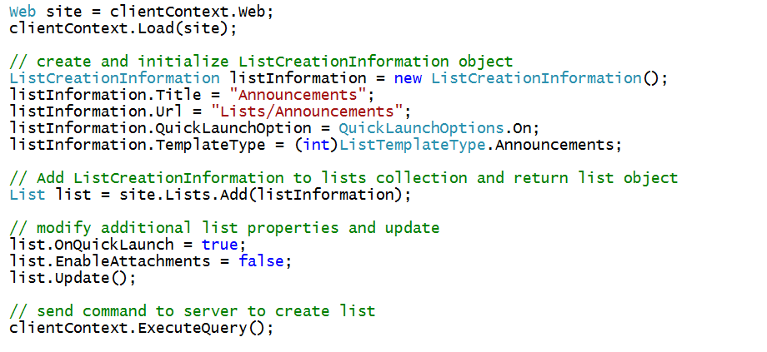
Creating a List

Slide 29
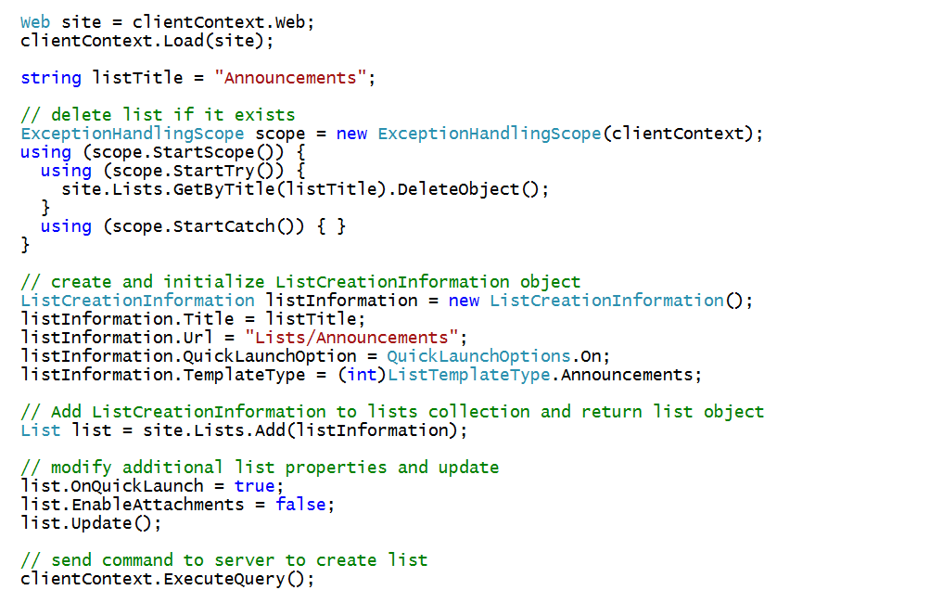
Checking Whether the List Already Exists

Slide 30
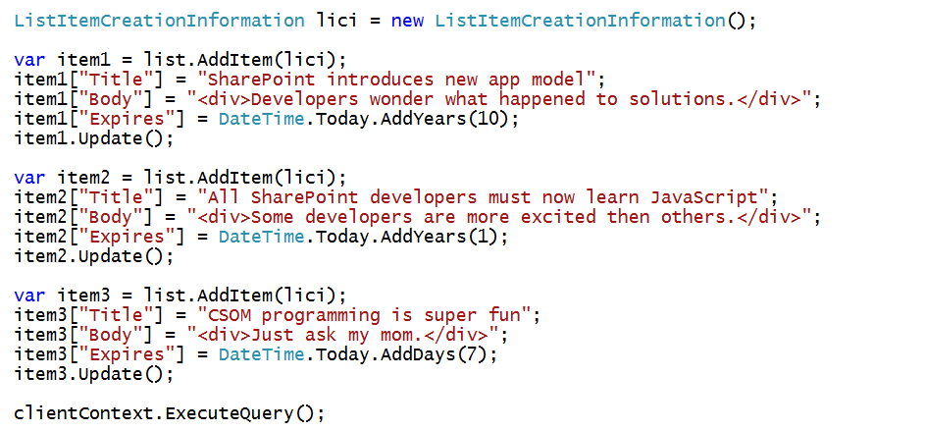
Creating List Items

Slide 31
Demo
4 Creating, Updating & Deleting Data with REST Services
Creating Content Types and Lists using CSOM

Slide 32
5
Registering Remote Event Receivers

Slide 33
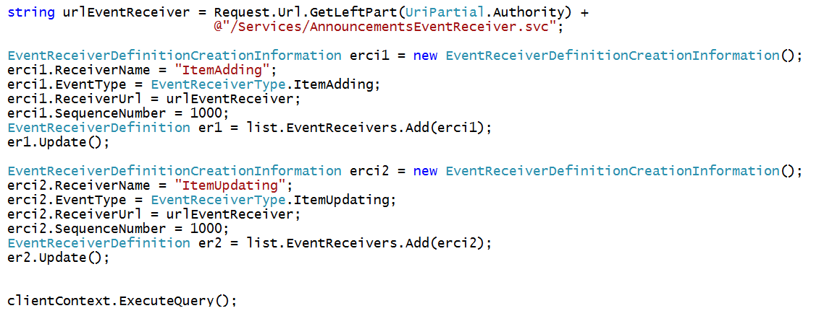
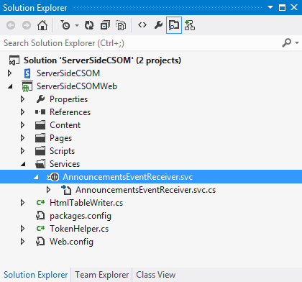
Registering Remote Event Receivers
Remote Event Receivers require registration
Declarative registration only possible in app web
Registration in host web requires CSOM code
Remote web must supply the required entry point (e.g. MyEventReceiver.svc)

Slide 34
Summary
Motivation
CSOM Overview
Optimizing the Execution of CSOM Queries
Creating Lists and Document Libraries
Registering Remote Event Receivers

Slide 35
Further reading…
SharePoint Code Samples
SharePoint Training videos and hands on labs
SharePoint documentation
SharePoint Patterns and Practices (PnP)

Slide 36
Engage

